Slide 1
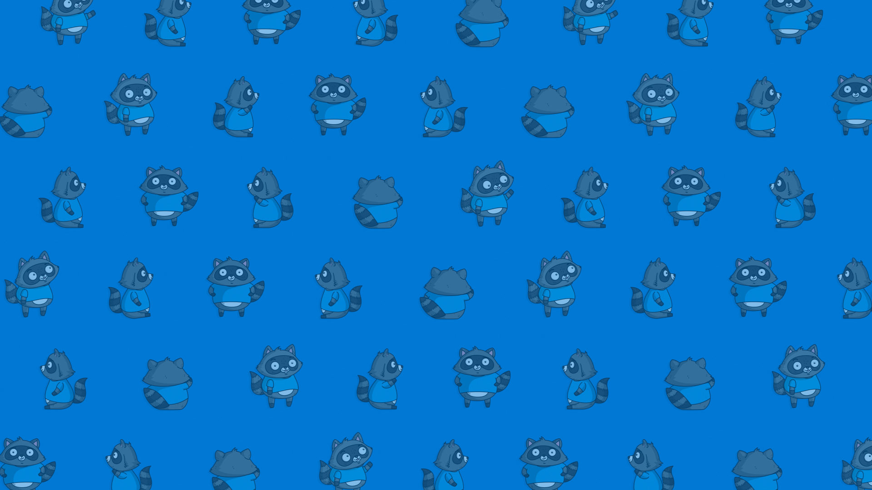
Cloud Skills Challenge
The Challenge is specific to this meetup group
Start: now until 11.59pm 28th March
All modules have been selected for this community.
Complete 5 modules or more to enter the prize draw or for voucher eligibility.
The prize draw will take place after the close of the competition and your community leader will be reaching out to help us contact you.

Slide 2
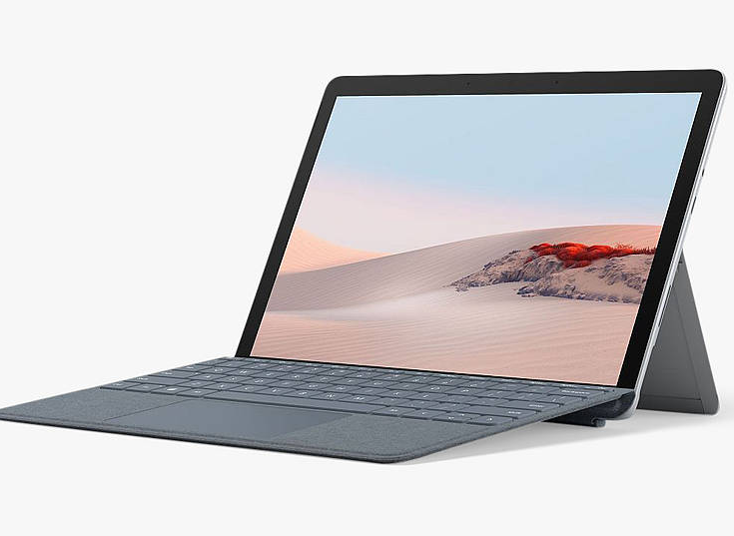
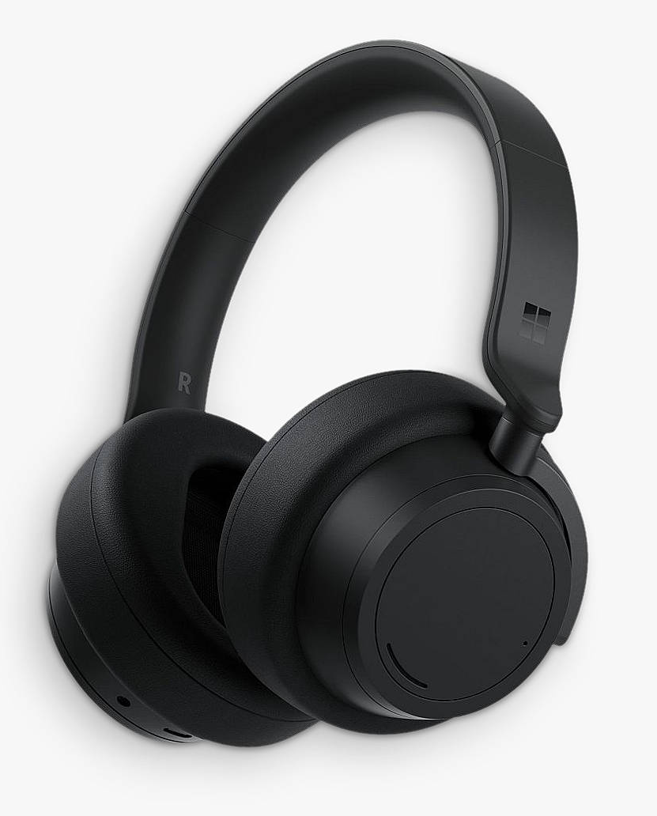
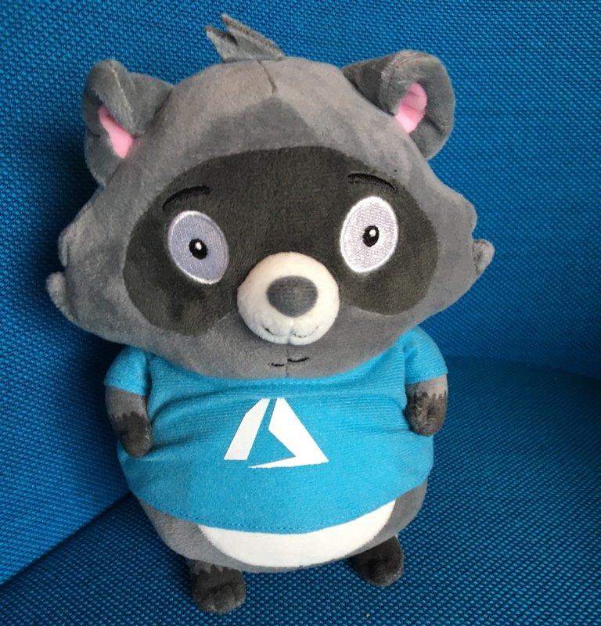
Prizes (UK residents)
1st Prize:
Surface Go 2 w/Surface Go Keyboard
+ "Bit" plush toy
2nd Prize:
Surface Headphones 2
+ "Bit" plush toy
3rd Prize:
"Bit" plush toy

Slide 3
Exam Vouchers
Complete 5 or more modules and then contact your community group leader to request a voucher for Microsoft Certifications.
Initially available to the first 20 requests
You will need to tell your community group leader what your display name is on the Challenge, so we can validate your participation.
Certification Exams to be taken by 31st May 2021.
Full terms & conditions here.

Slide 4
THE CLOUD SKILLS CHALLENGE:
https://aka.ms/challenge/BNMUG
TERMS & CONDITIONS: https://aka.ms/BNMUG/terms-conditions

